Slide 1


Aflagame Project

Slide 2
Project Aflagame
The Aflagame project focuses on the gamification of financial literacy, mainly through the creation of board games that increase life skills and improve the financial behaviour of young people.
"Games are the highest form of inquiry" Albert Einstein.
We agree and recognize that games are the most challenging and engaging driving forces of creativity, learning, and development. They are complex, structured and "programmed" forms of play that have educational potential.
In fact, play is now unanimously considered fundamental for the emotional, cognitive and relational development of children.
Article 31 of the UN Convention on the Rights of the Child also recognises the right of children not only to rest and leisure, but also to play and recreation.

Slide 3
Project Aflagame
The project, a continuous work of comparison and participation between the six partners involved, has given life to 6 educational games on social and financial skills, all tested locally.
Secondly, a complete set of each game was created, including description, rules, materials and layout.
The collection of games, created as educational resources, will be shared within the Aflatoun network through a large network of EU organisations.
The creation of a public online learning course, a playbook for game design and the creation of your own educational games will be published on the Erasmus+ platform

Slide 4
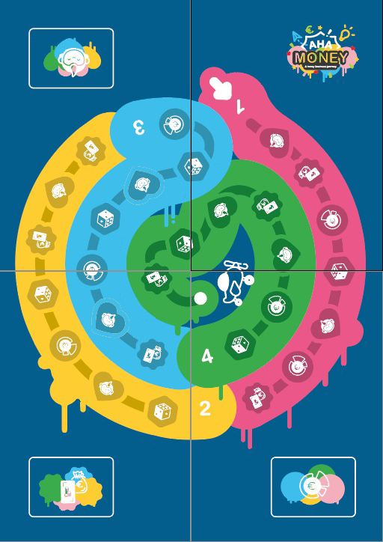
IG Students, Italy: Aha!Money
If the parents go on a long trip and are away from home for a long time, the child is alone at home during their absence. Aha! Living alone for a while is quite an adventure, but with a small amount of money he has to get by until they return.
What?
A board of 30 squares, or 4 weeks of challenges, quizzes and special events, in which you will find yourself playing the role of the various characters of Aha! Money, each with its own superpowers.
Objectives:
Develop awareness of the concepts of finance and economics, through "learning by doing"
approach the world of work, learning what a mini company consists of.
Learn how to manage your finances
learn to recognize your skills, talents and strengths and how to improve them
train teamwork, the spirit of competition and collaboration

Slide 5
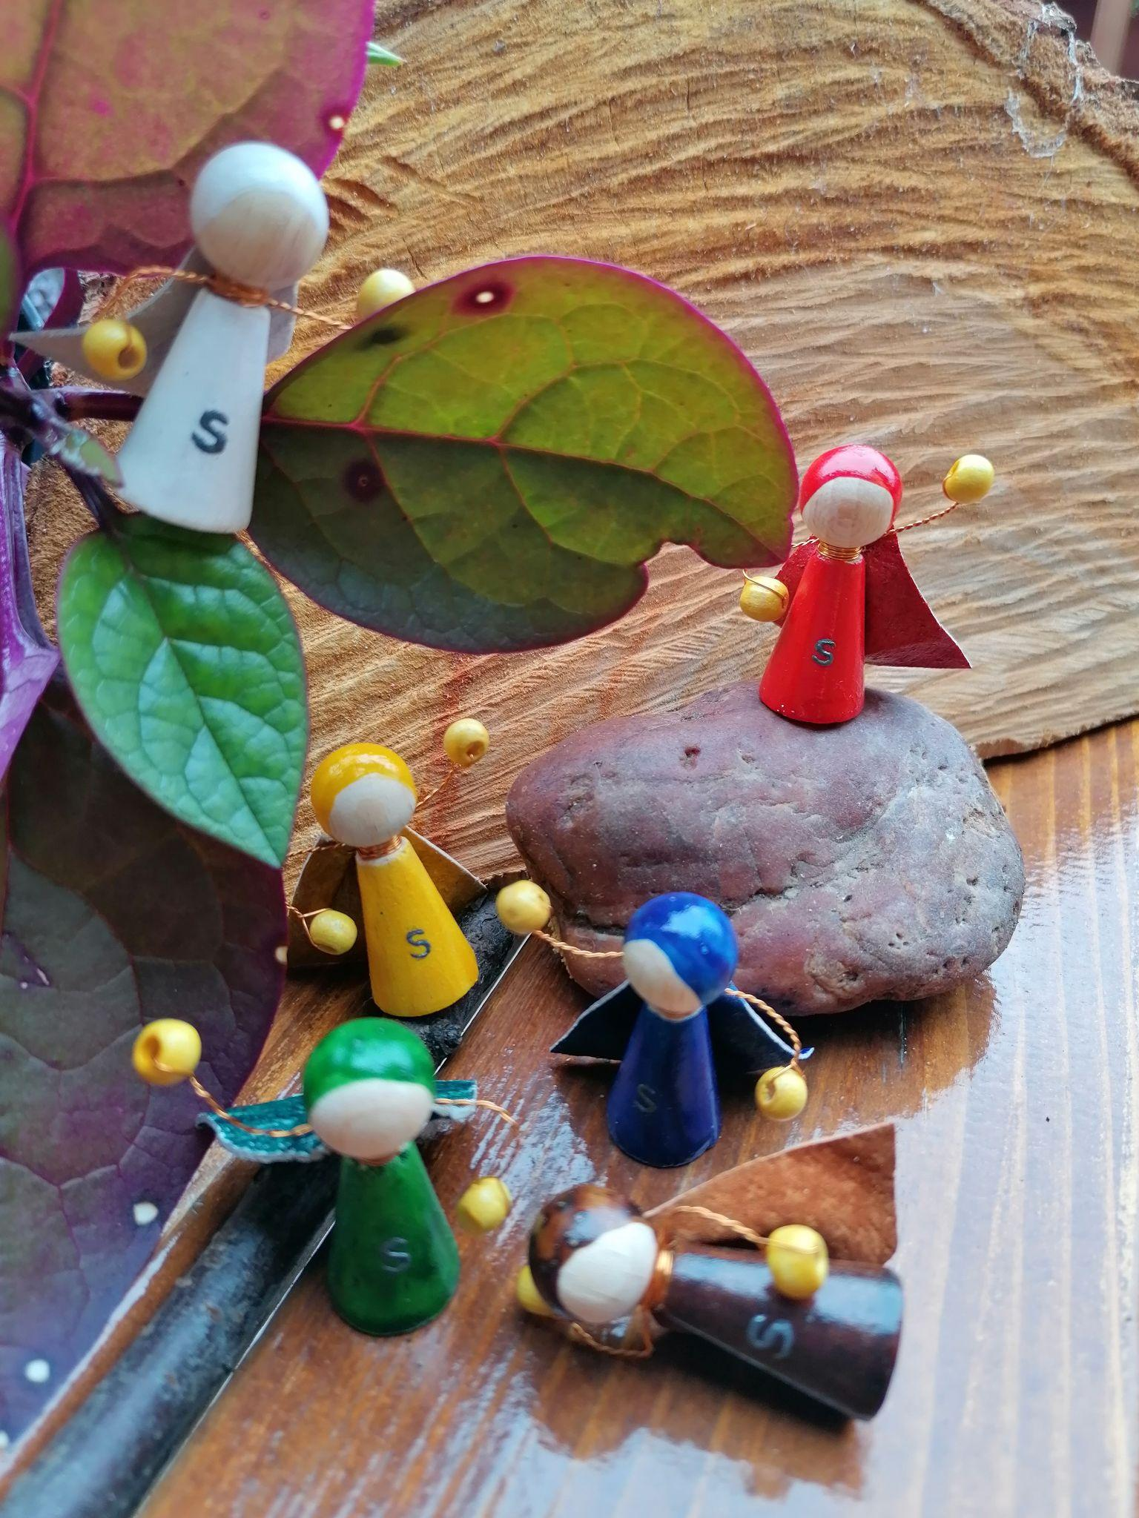
Hungary:
You are Enough
Reflecting on the educational opportunities that exist for adolescent boys from disadvantaged backgrounds, the game is born that makes them aware of their being Superheroes.
Based on the cooperative method of active listening and the support of a game master, the boys learn that they "are enough": their personal values, strength and unique individuality are the greatest adventure and the most challenging task they will ever have in life.
A board, eight avatar tokens, varied cards, a die and many colors to throw yourself into self-exploration and start orienting yourself for school and the future.
Objectives:
Know your skills and abilities
improve self-knowledge, social skills, and develop financial and economic skills.

Slide 6
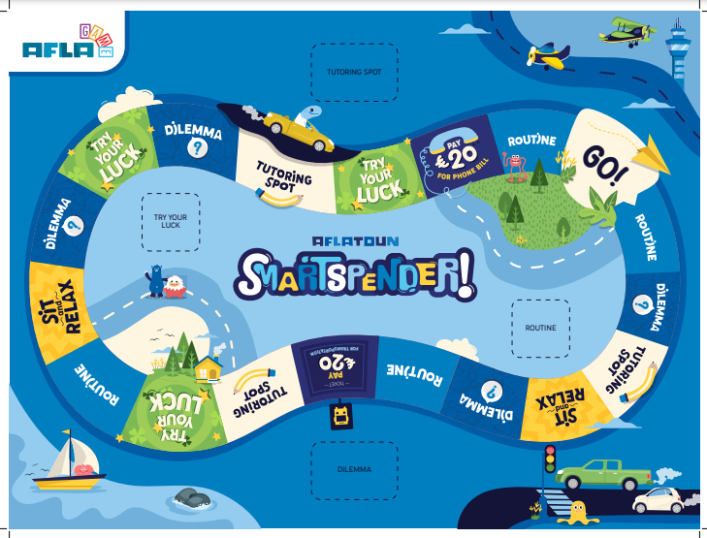
Aflatoun, Netherland:
Smart Spender
Holland is a game for everyone; It will allow players to experience spending and saving in a fun and interactive way. Learn how to make smart decisions and gain awareness of the community and the environment.
Everything starts and revolves around being SMART: a board, cards and pawns, but the role of the Bank is fundamental, distributing and managing points and money.
What's the goal?
Complete your mission by earning the amount of smarts (fictitious currency for this game) and green and social points on the Mission Card.

Slide 7
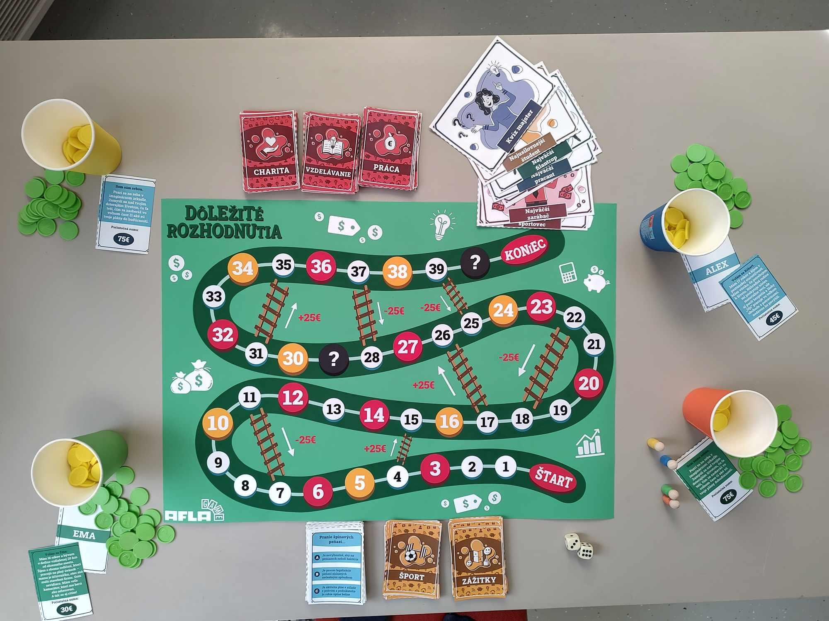
Slovakia:
Important Decisions
Starting from the crucial social context of the territory, the team creates and develops a collaborative game, based instead of competition, on the key concepts of: time, empathy and collaboration.
A board, cards, pawns and dice, everyone has a role in this society. Participants learn to manage their time and money, think about what is important to their lives, and learn to focus not only on themselves, but also on the fate of other people and the impact that different life circumstances might have.
Objectives:
Learn how to spend, earn and save money,
Dealing with positive and negative situations that can impact finances
Dealing with different life situations and learning how to
understand the different starting points and
their impact on people's fates.
Learn how to make decisions according to
personal needs and to work to the fullest of one's own
time available.
Become more flexible and develop social skills.

Slide 8
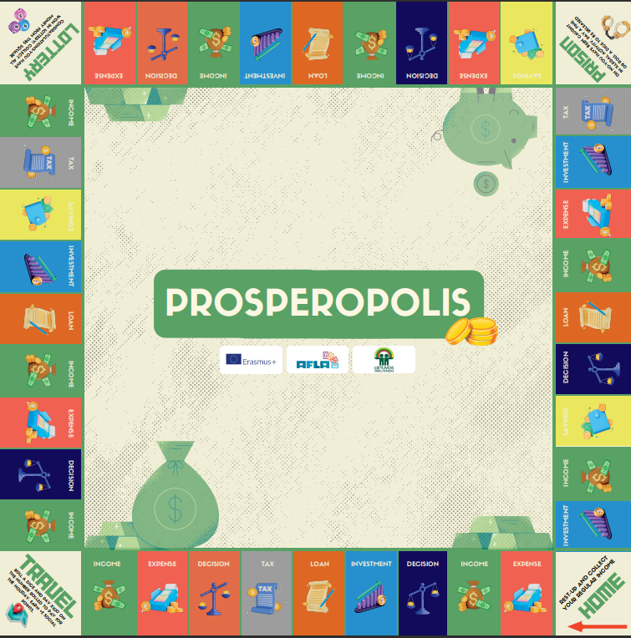
Lithuania:
Prosperopolis
Drawing inspiration from the real-life experiences of young Lithuanians, the Lithuanian game was developed.
The narrative develops on the idea of the journey to financial independence, in a collaborative and fun way, incorporating elements of financial decision-making, investing, saving and social interactions.
Kids understand what it means to achieve financial security and formulate a long-term plan, while accumulating social points, through the tasks on the Decisions, Investment, Expenses, Income, Taxes, Savings, and Loan cards.
Objectives:
Achieve a balance between wealth and social reputation;
Manage a budget; Investing income over time
Sustainability of expenses; Investment strategies; Tax knowledge;
Saving habits; Debt management; Retirement planning; Risk assessment;
Social Points and the Influence of Social Interactions
Long-term planning

Slide 9
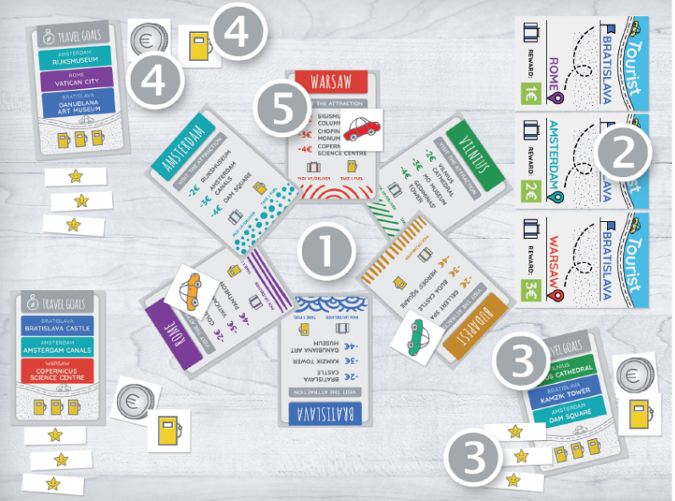
Poland:
Aflatour
AflaTour was created for kids who like to visit attractions in the biggest cities in Europe.
On a budget, you set off on a vacation on 4 wheels, trying to earn funds along the way to pay for tickets to the best attractions.
Si possono caricare altri turisti, acquistare carburante per raggiungere gli obiettivi.
It's a simple and interactive game, where you learn strategic thinking and long-term expense planning.
Objectives:
Learning European Geography
Competitiveness and collaboration
Budget planning
Strategy for achieving goals

Slide 10
Project Aflagame
During the implementation of the project we had a positive impact on future users and trainers through:
improving the quality of youth work in the field of financial education.
increased initiative and entrepreneurship;
improving skills levels for employability and business start-ups (including social entrepreneurship);
more active participation in social life;
increasing the financial literacy of children and young people;
improvement of skills, linked to professional profiles (teaching, training, animationsocio-educational, etc.);
a better understanding of education, training or training practices, policies and systems
young people in the various countries;
a better understanding of the connections between formal and non-formal education, training
other forms of learning
labour market;
Increased opportunities for professional development

