Slide 1

Aflatoun
Sustainability Challenge
Childfund International in Indonesia with Local Partner

Slide 2
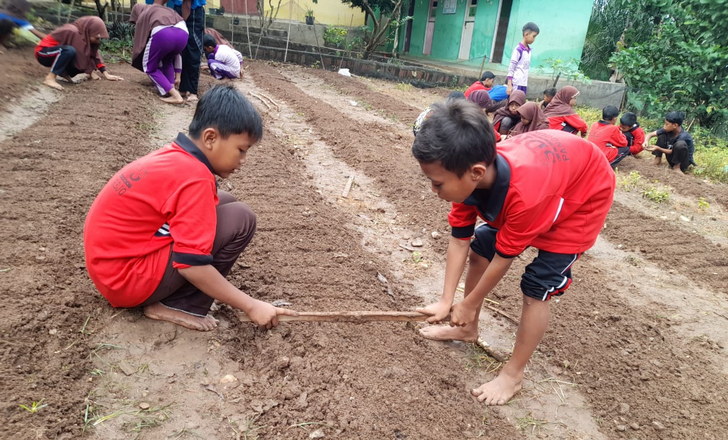
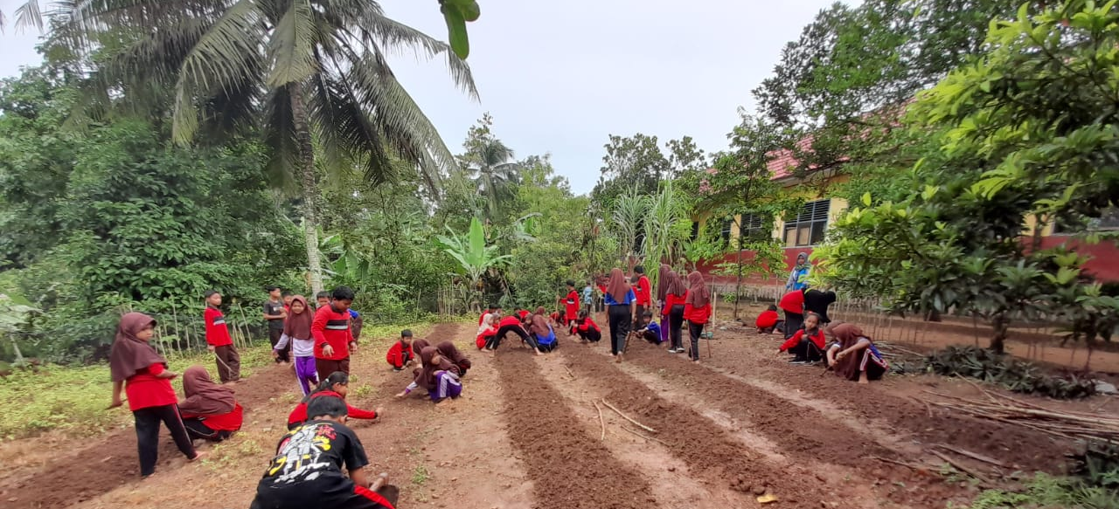
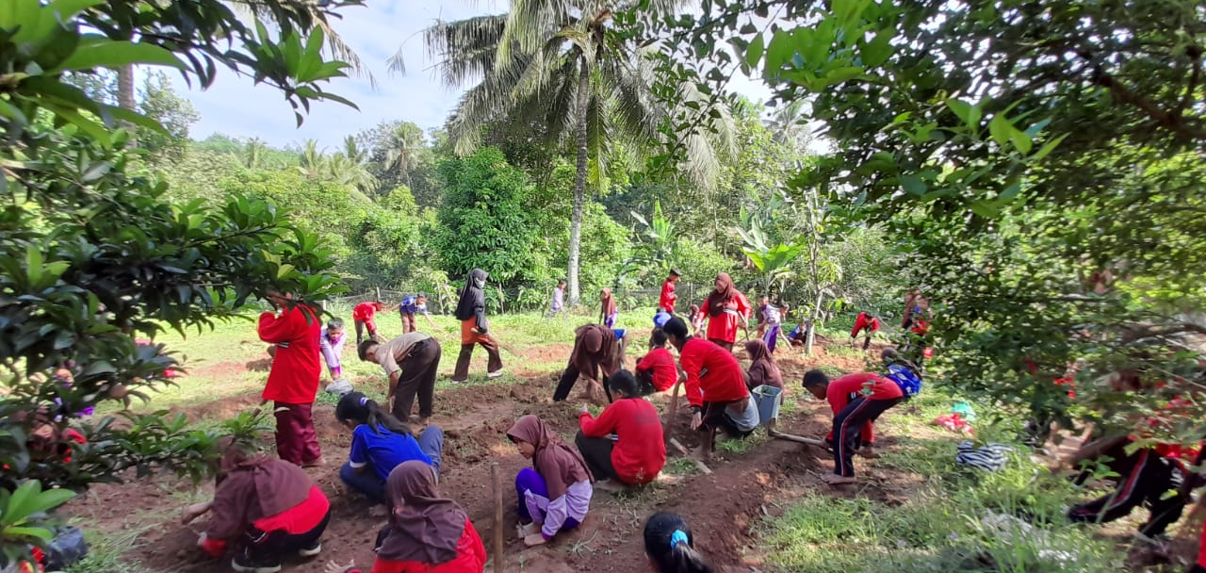
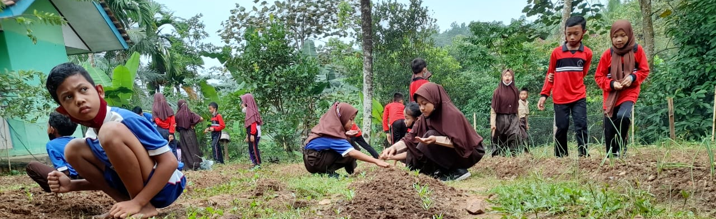
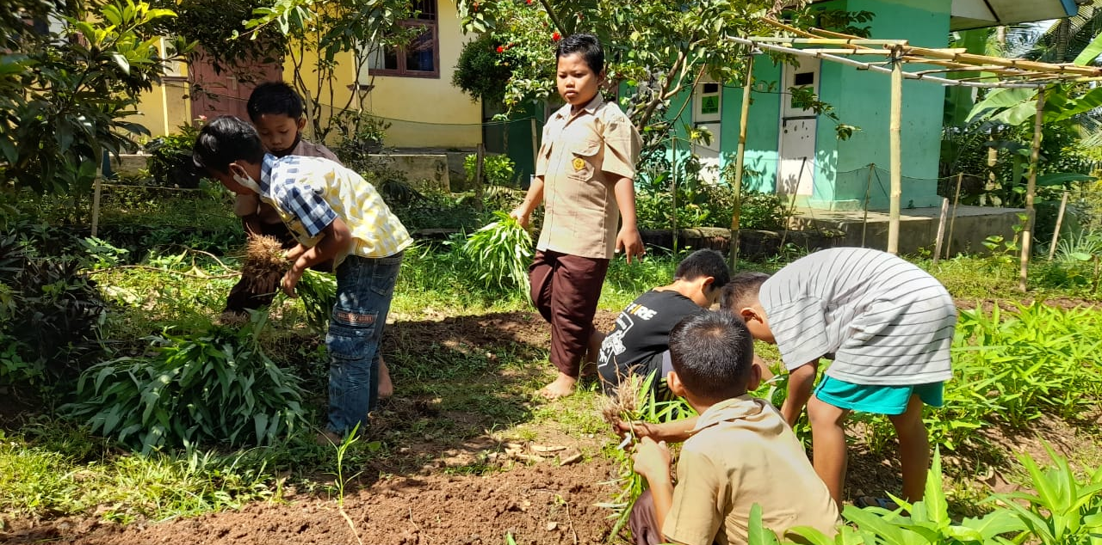

Slide 3
Transformation school garden into business garden
The LSE-FL (Life Skills and Financial Literacy Education) group at SDN 2 Panggungrejo, Pringsewu Lampung create a business garden in their school environment. They started by clearing the land, then they make a planting path, after that planting water spinach seeds. They also routinely caring for the plants until the water spinach is ready to be harvested and sold to the community. The money raised from the sale will be allocated to a group fund.
Resource: YPSK LDA Lampung (partner of ChildFund International in Indonesia

Slide 4
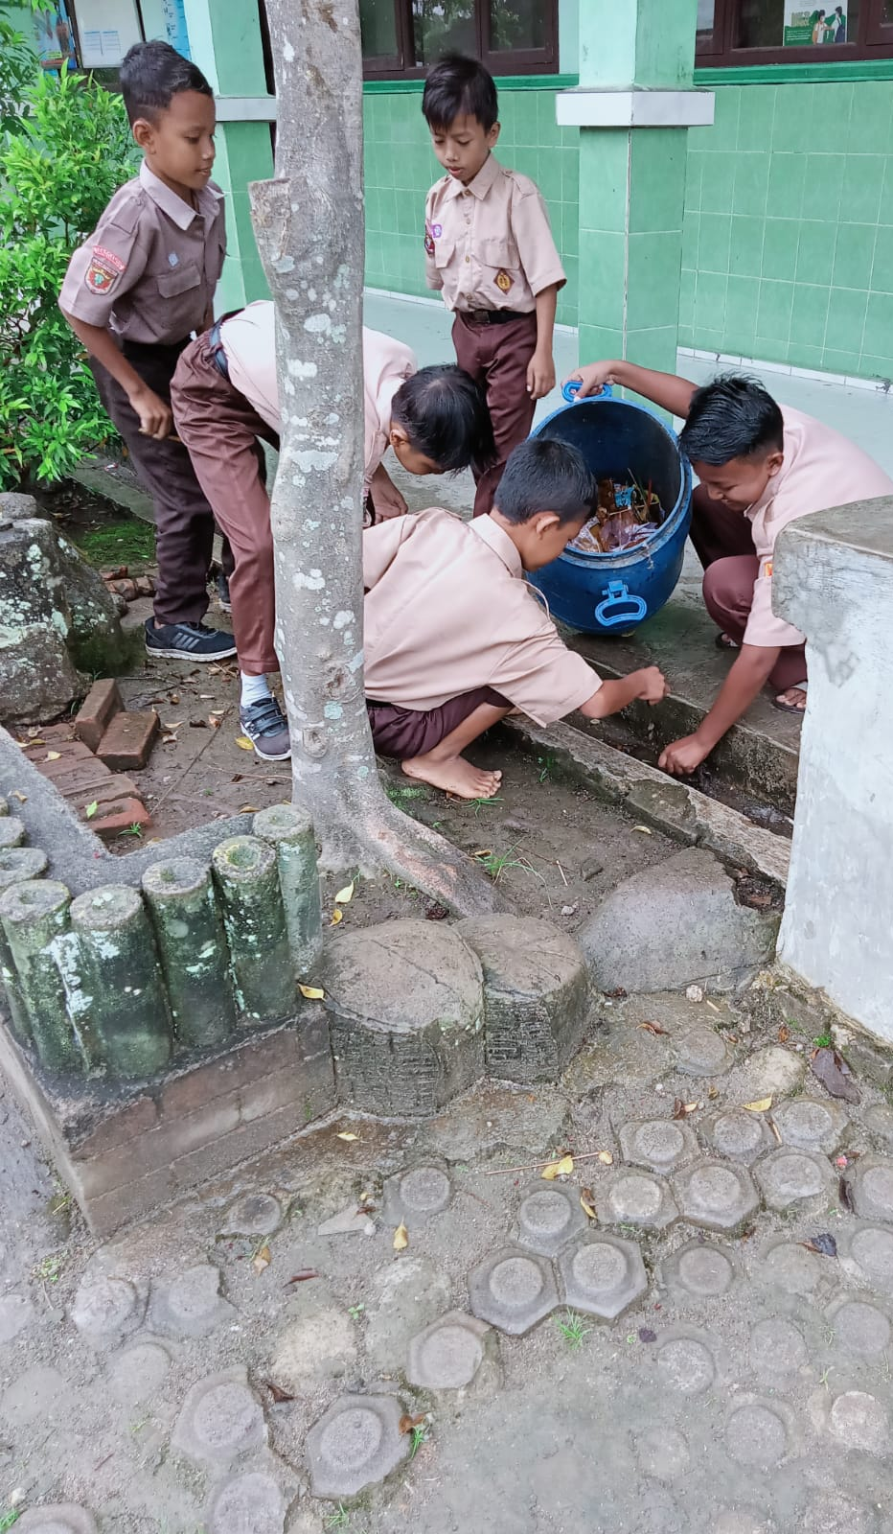
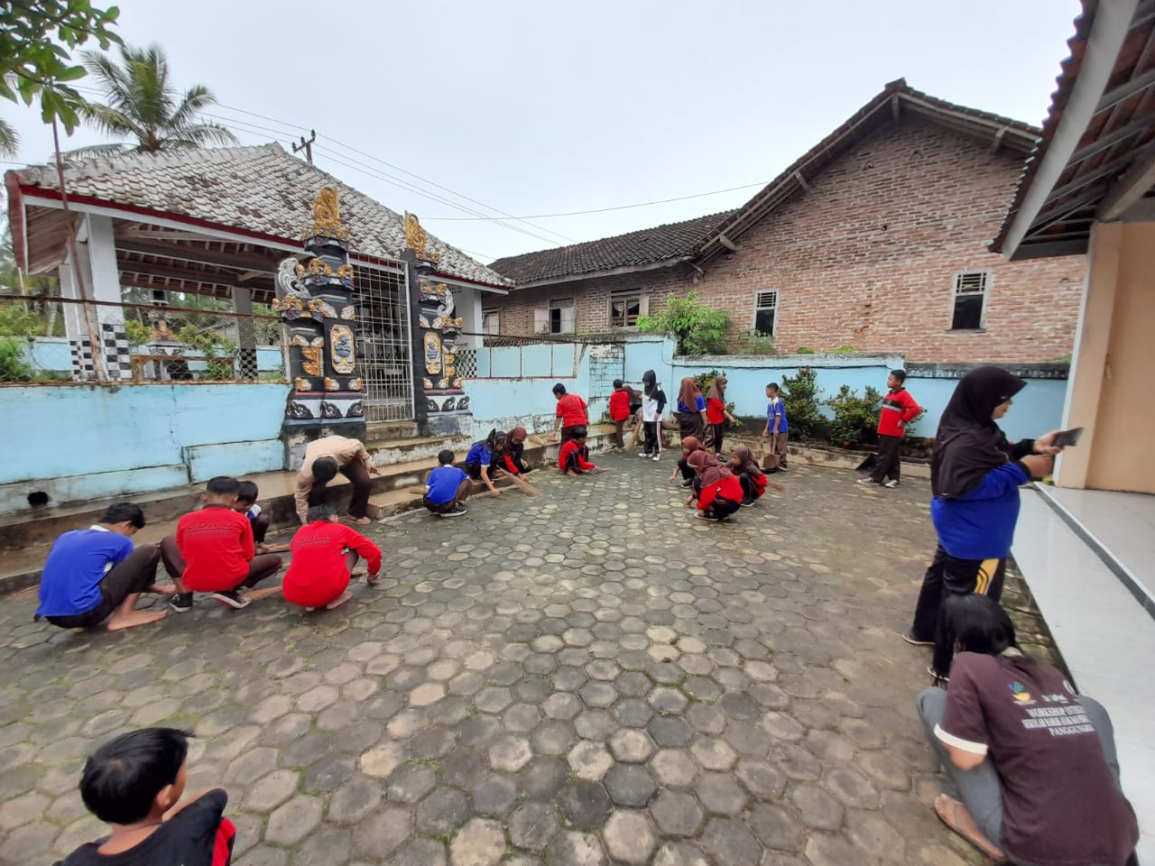
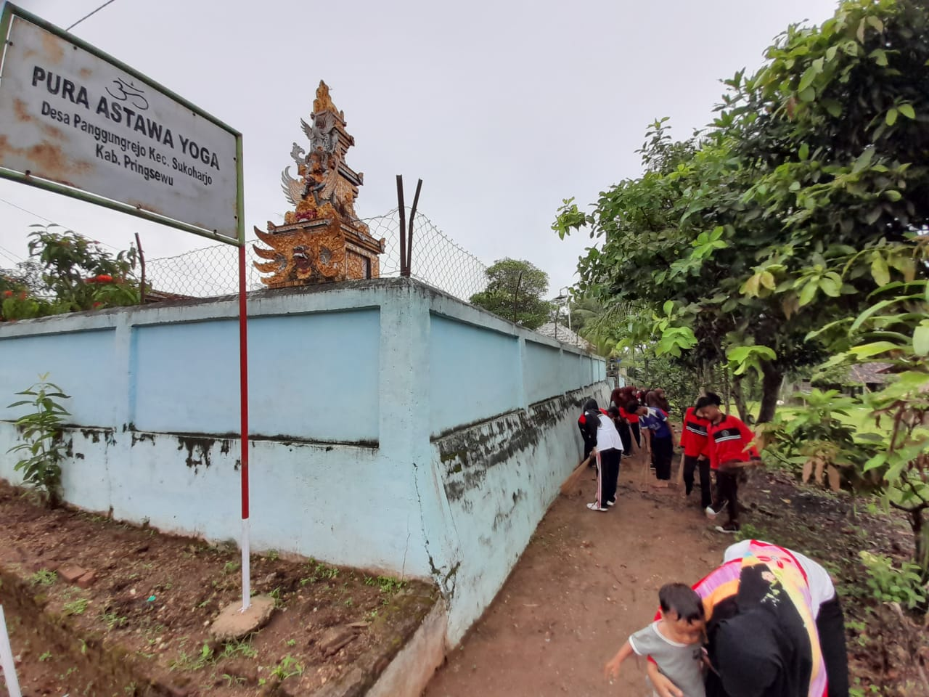
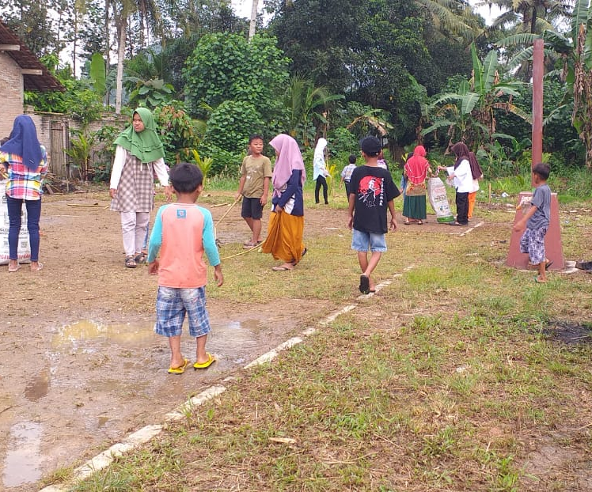
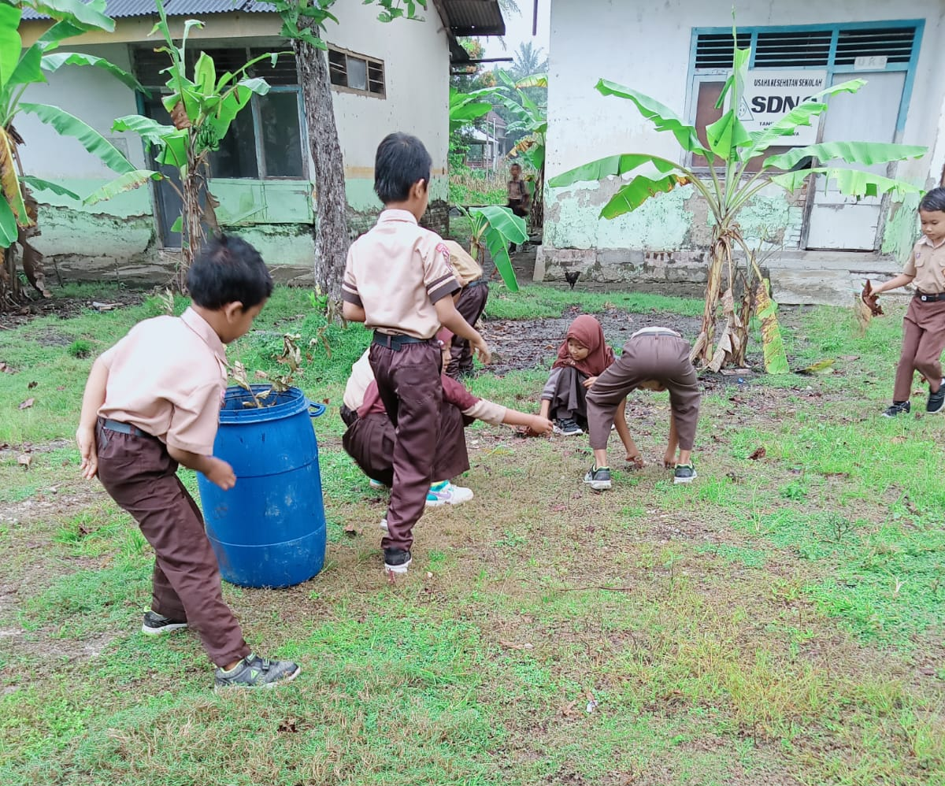

Slide 5
Let’s Keep our environment clean!
Children in Pringsewu District took joint action to clean up the environment, including the school environment, public places and places of worship. According to them, everyone has a responsibility to protect the environment.
Resource: YPSK LDA Lampung (partner of ChildFund International in Indonesia

Slide 6
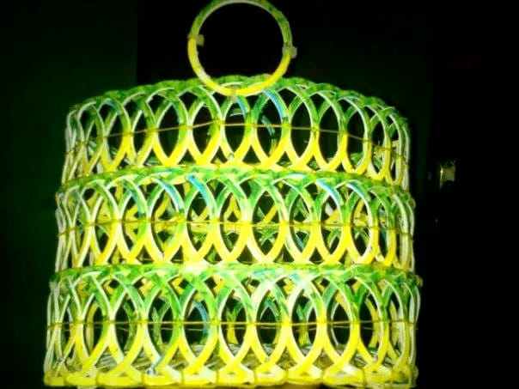
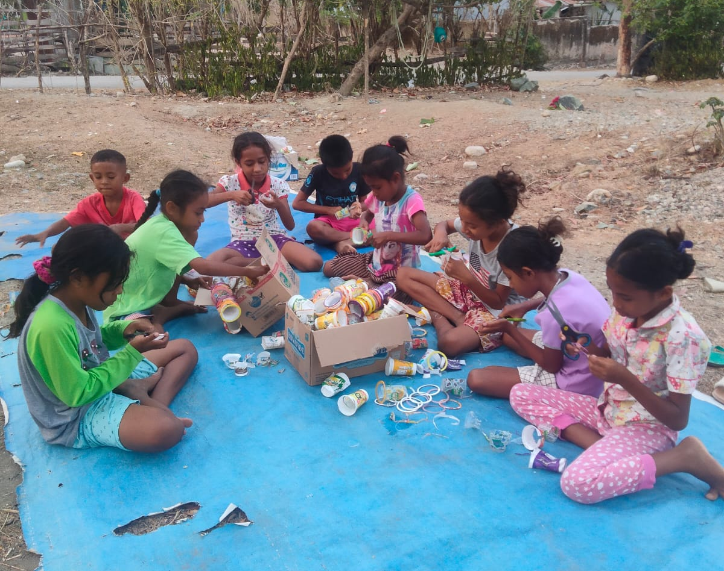
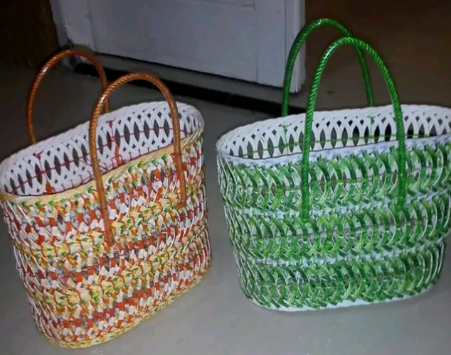

Slide 7
Let’s turn trash in to the cash!
We are children from Lopo Cerdas YKPA Belu. By learning social and financial business session, we learn to recycle plastic waste into bags, tissue holders and placemats. We sell the product, and we distribute the money to be saved in each other's piggy banks. But some the earning money, we also use to visit friends at the orphanage and play with them.
Resource: YKPA Foundation (partner of ChildFund International in Indonesia)

Slide 8
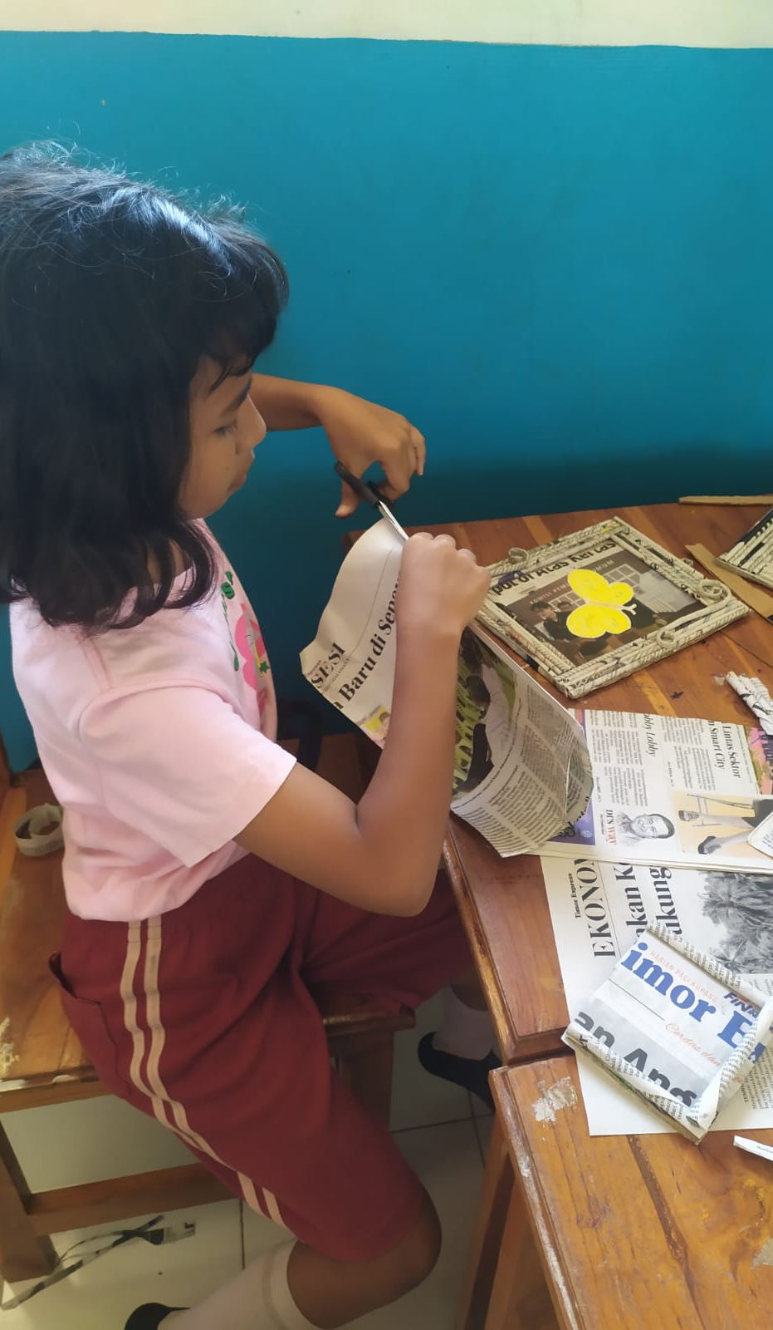
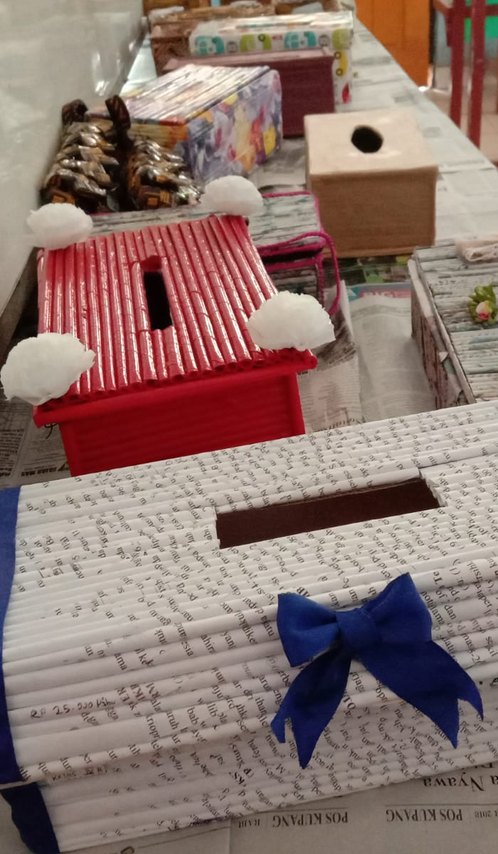
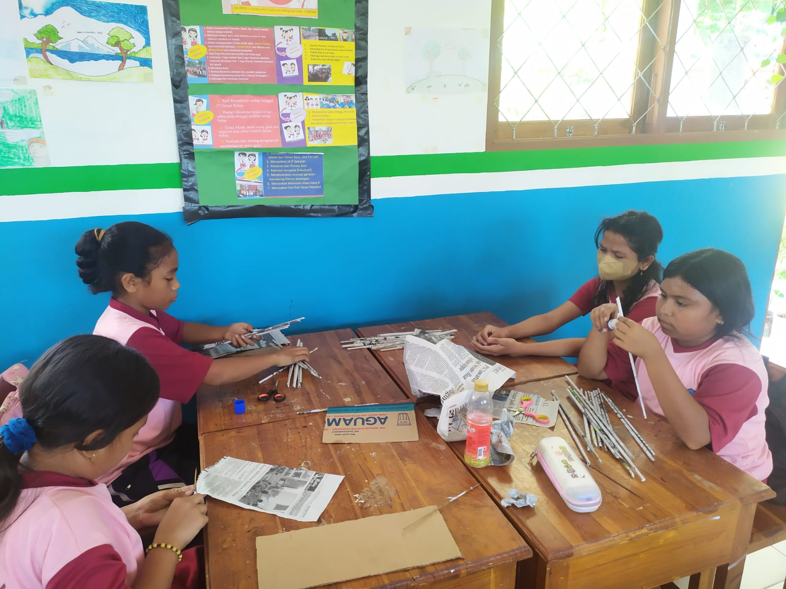
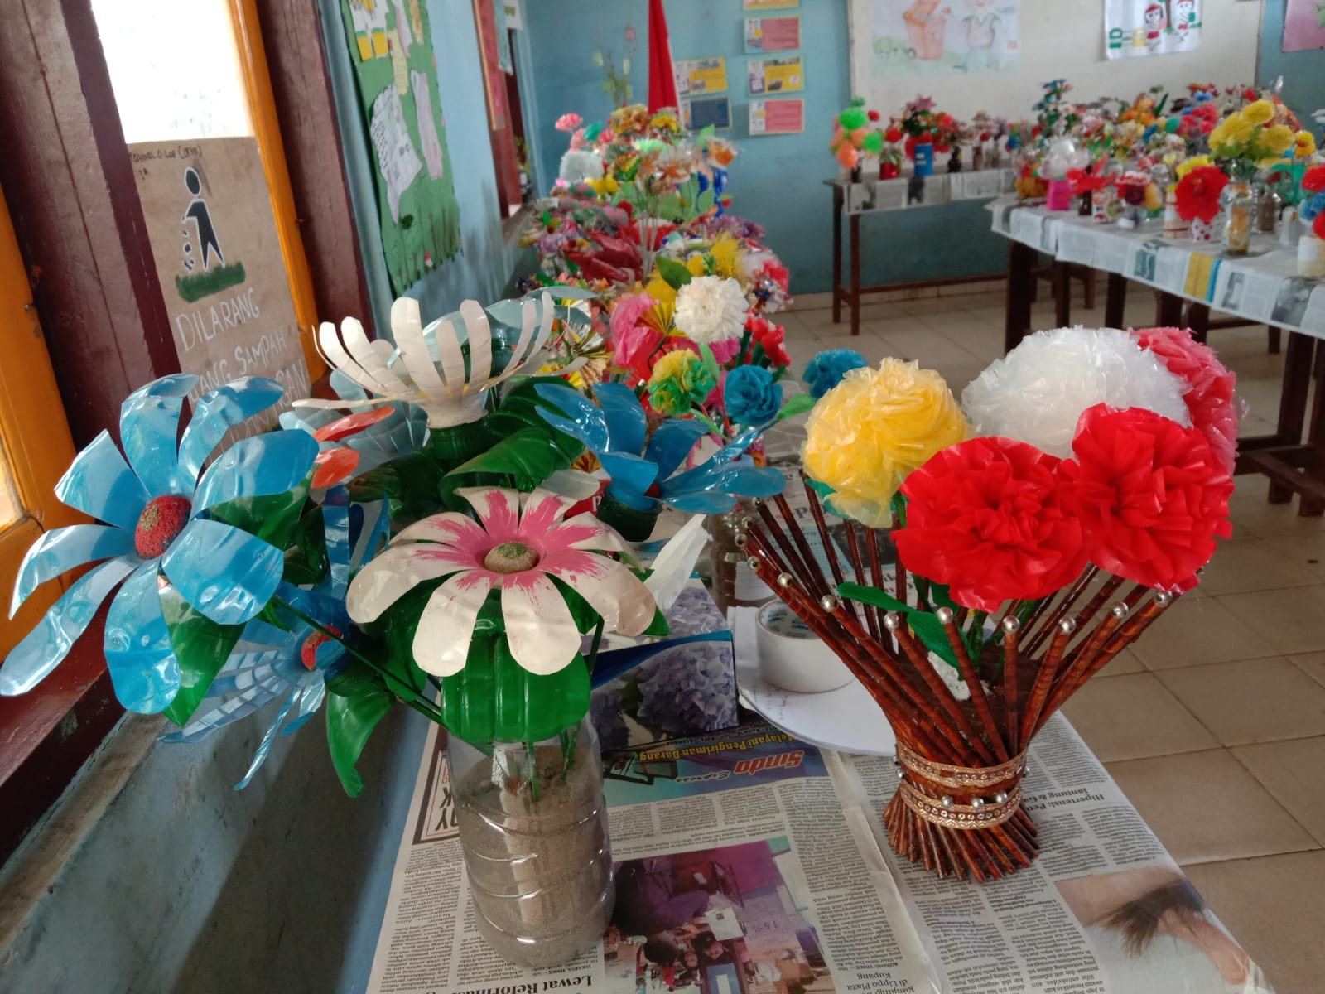

Slide 9
Love and protect our planet through recycling
Greetings from Liliba Public School students in Kupang districts. One of the positive lessons we learned in the sessions on life skills and financial literacy is that everyone has a duty to protect and care for the environment. Waste recycling is one form of action. Have a look at what we have made from newspaper and plastic waste in our environment. We create a variety of useful and beneficial things, such tissue boxes from newspaper rolls and beautiful flower arrangements from plastic waste.
Resource: YACITA/ Cita Madani Foundation (partner of ChildFund International in Indonesia)

Slide 10
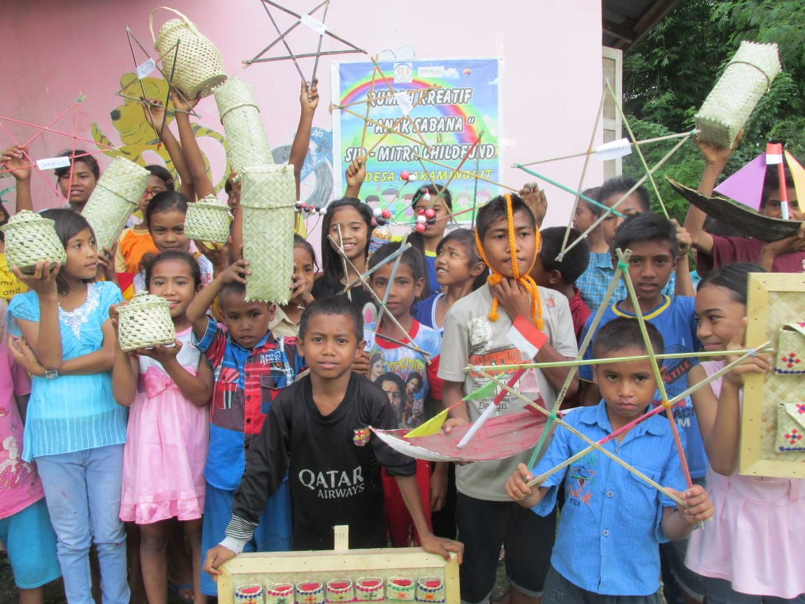
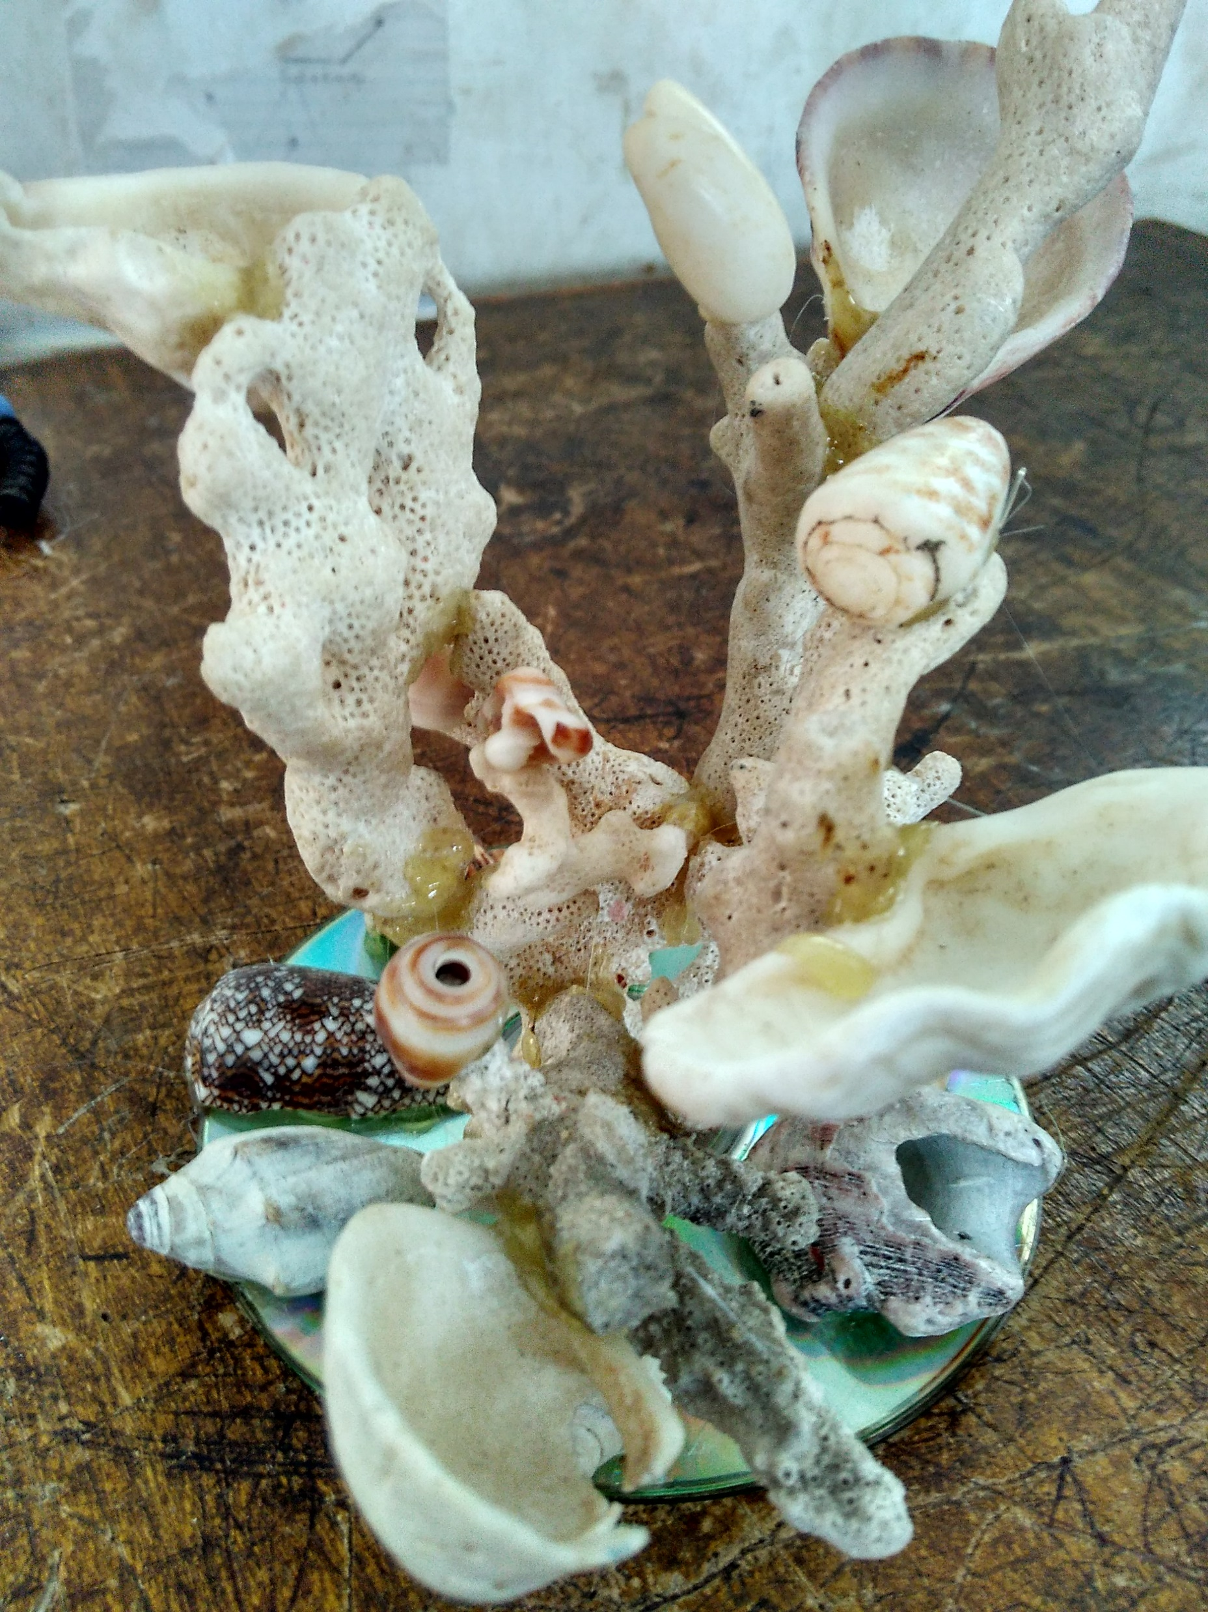
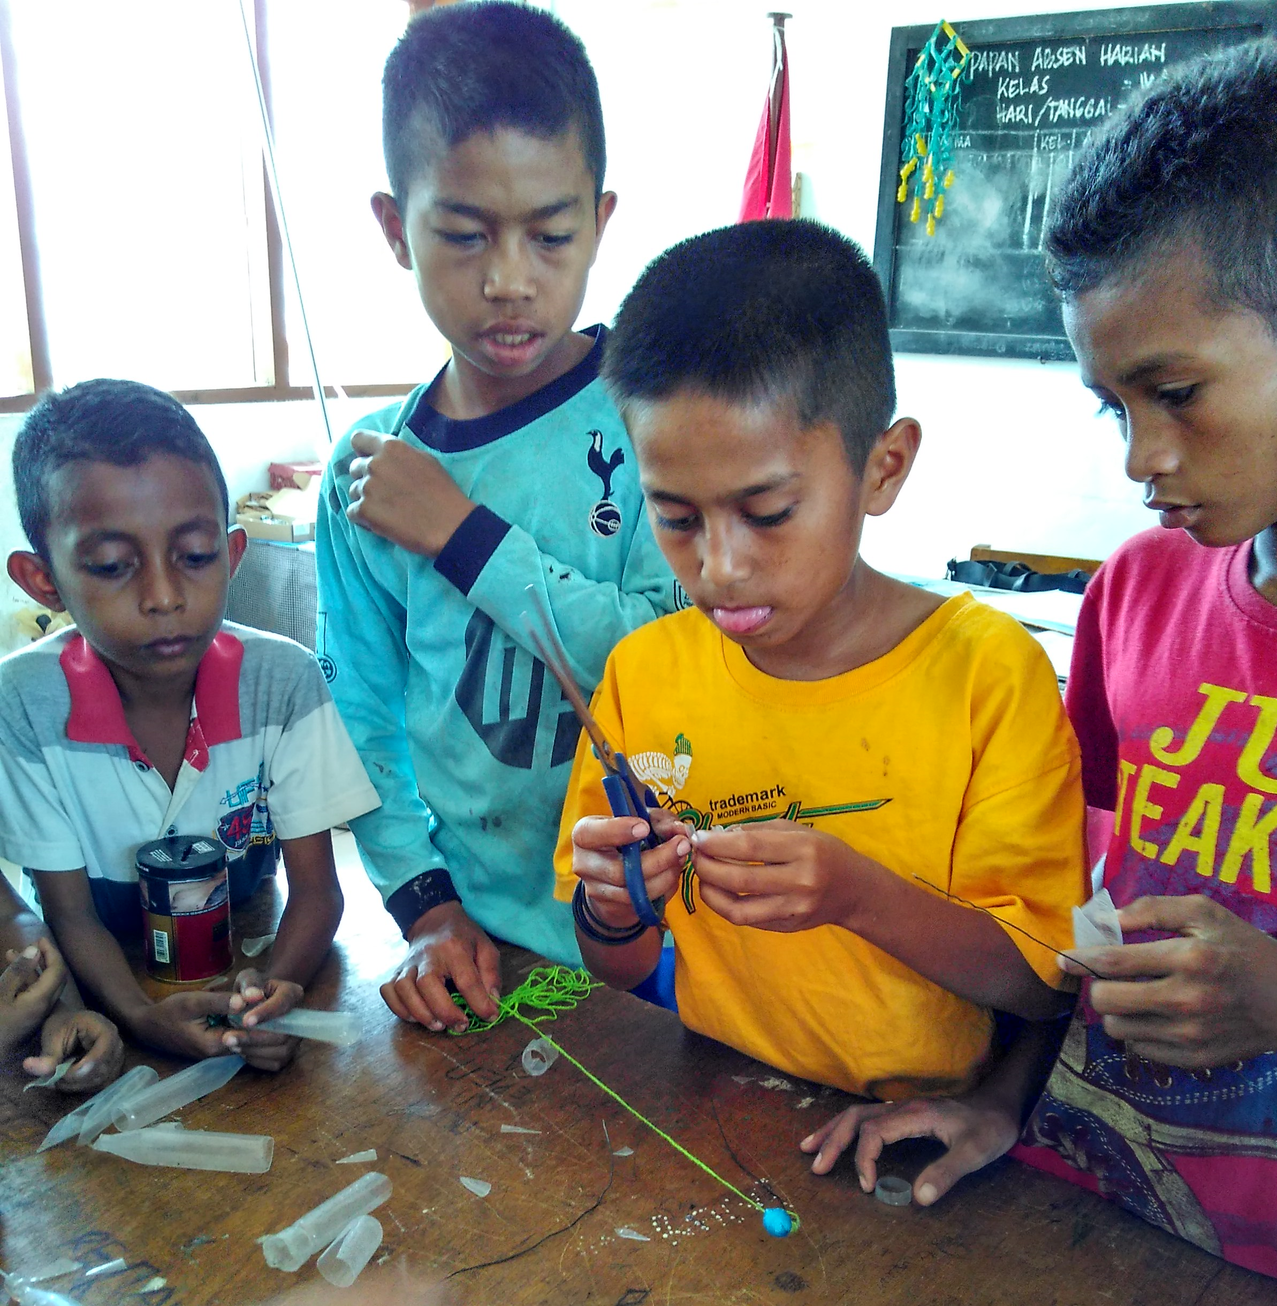

Slide 11
Recycling is magic, turning something into treasure!
Children in the village of Waimangura on the island of Sumba create various objects from materials around them. Palm leaves are made into a variety of useful boxes and wall hangings, while bamboo slats can be used to make star-shaped wall hangings. Palm fronds are also used as boat toys. Recycling activities indirectly inspire us to use the materials around us in a sustainable manner. Let's think creatively and sustainably!
Resource: Sumba Integrative Development Foundation (partner of ChildFund International in Indonesia)

Slide 12
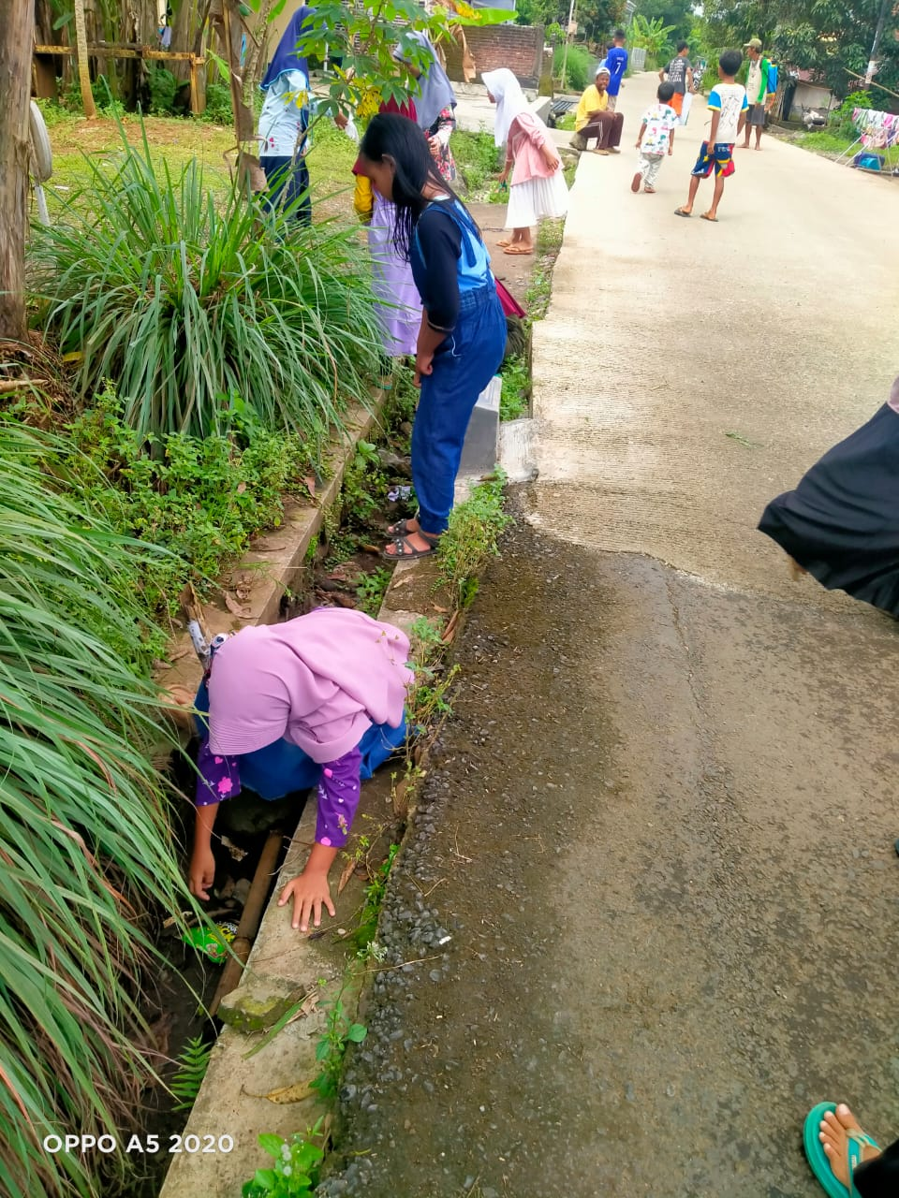
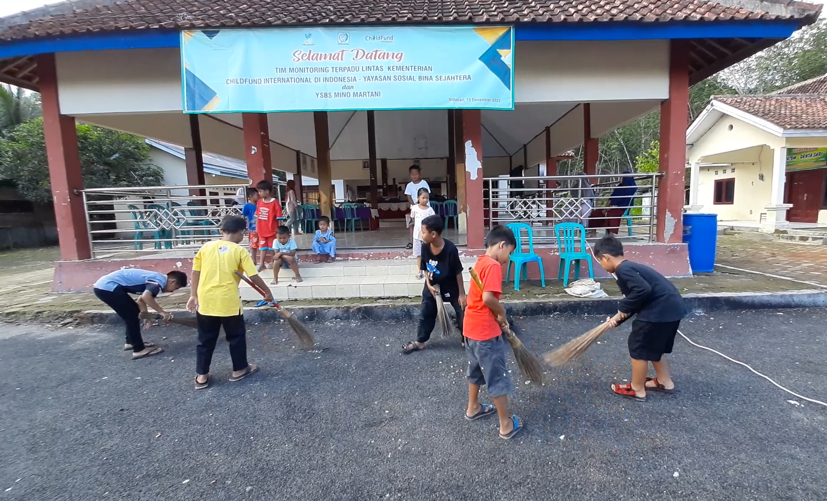

Slide 13
Together, let’s keep our environment clean.
Children from Sidasari Village and Kalikidang Village carried out an environmental clean-up action as a concrete demonstration that children have the same role for maintaining and protect the environment as same as adult.
Resource: YSBS Mino Martani Foundation (partner of ChildFund International in Indonesia)

Slide 14
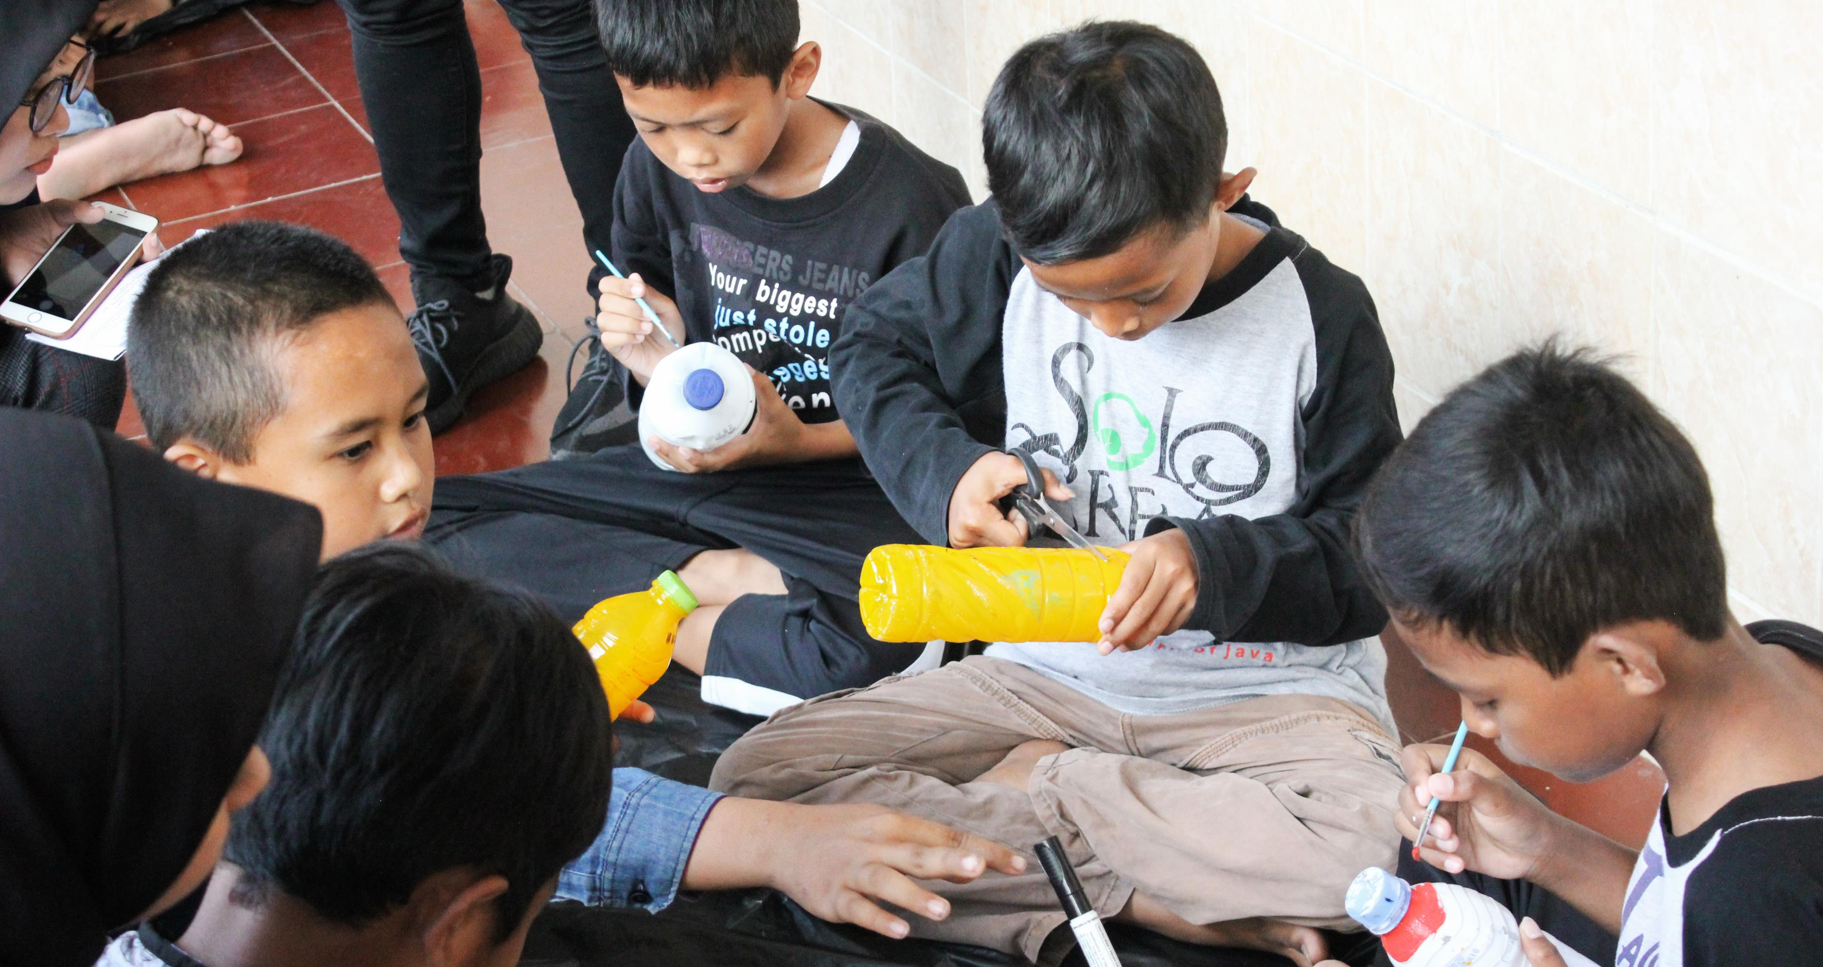
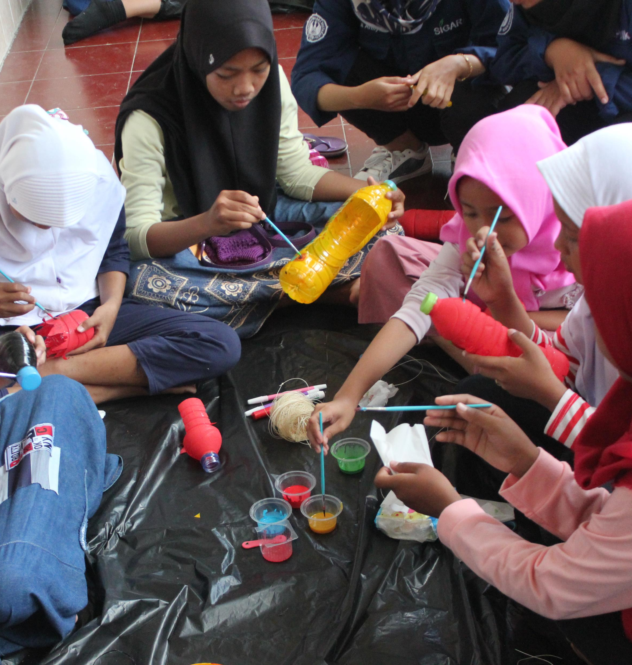
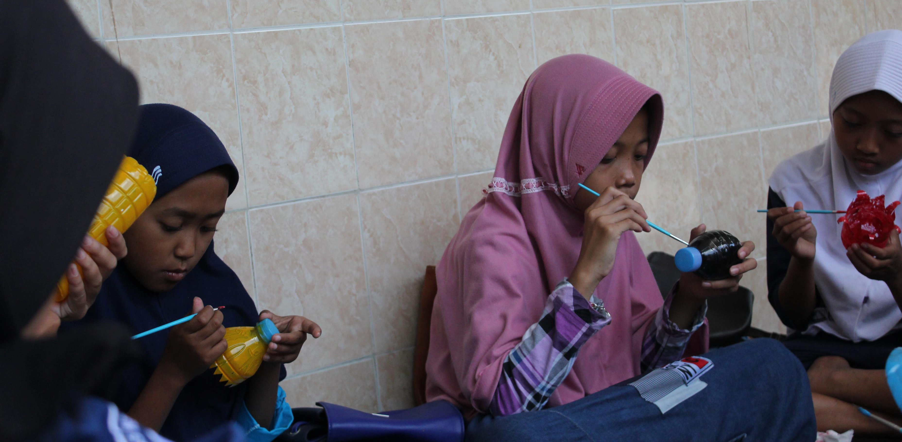

Slide 15
Sanggar Pasaran Crafting
Children from Sanggar Pasaran in Kulon Progo-Yogyakarta make pots from plastic or glass bottles. After they clean the bottles, they cut it and then draw and decorate the bottles. The purpose of this activity is to teach them about the importance of waste management by reusing waste into items that have use value (reuse). After the pots are done and dried, children can use them to grow plants and hang them as decorations in front of the house.
Resource: PBMM MAS (partner of ChildFund International in Indonesia)

Slide 16
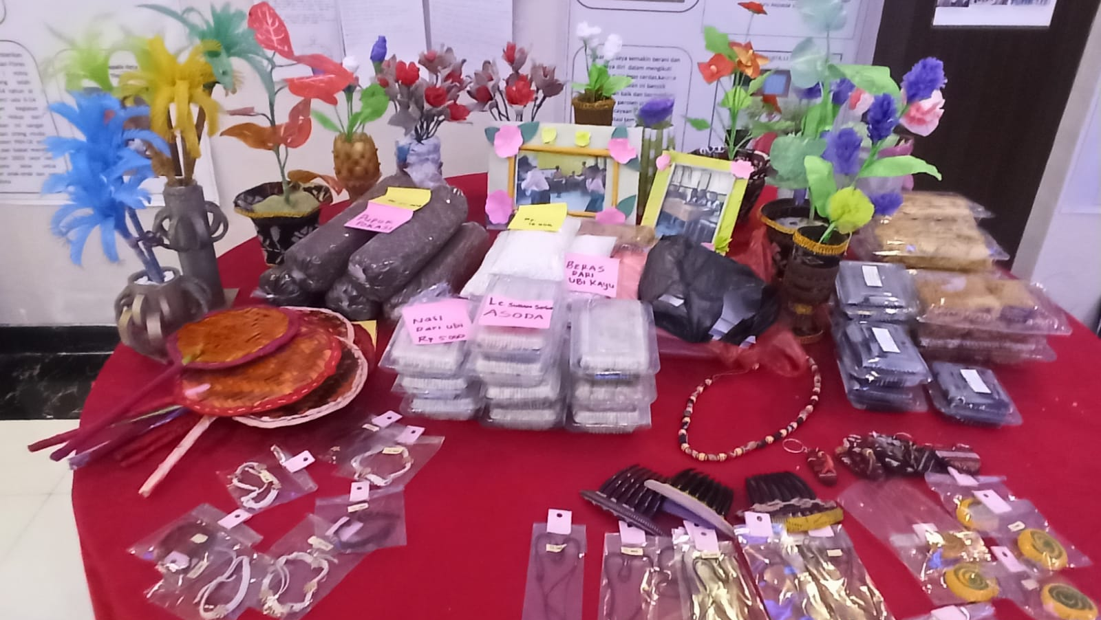

Slide 17
This is my handiwork, and I'm proud with it!
Children from Lopo Cerdas in Ende, Sika and Flores display the product of their social and financial enterprise. The various products on display are the result of collaboration between the children and their facilitators. Some of their products are food made from local ingredients, bracelets and necklaces, key chains, natural fertilizers, fans made of rattan leaves and flower displays made from plastic waste.

